Slide 1
Forms, PHP, and Form Processing

Slide 2
Form Processing
Web Server
Form
Response
Query
CGI
Program
Web Browser
The server side program to process incoming HTTP requests should conforms to the Common Gateway Interface (CGI).
PHP is a popular language for implementing CGI programs.

Slide 3
A Simple Form
<form method="post" action="welcome.php">
<pre>
<label for="n">Full Name:</label>
<input id="n" name="client_name" size="25" />
<label for="e">Email:</label>
<input id="e" type="email" name="client_email" size="25" />
<input type="submit" value="Send" />
</pre>
</form>
Demo: Ex: SimpleForm

Slide 4
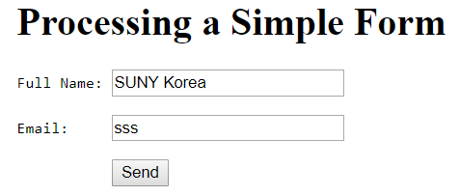
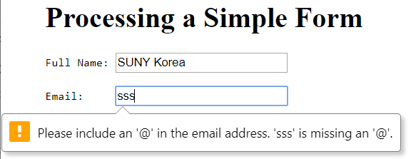
A Simple Form

Slide 5
Basic Input Elements
A typical form element consists of these essential parts:
Instructions for the user on what information is sought and how to fill out the form.
Blank fields, produced by input collection elements, to be completed by the user.
Text or label for each input control to clearly indicate the exact information to be entered.
A button or a submit type input element, for the user to click and submit the completed form.
An HTTP query method, given by the method attribute of form, for sending the formdata to the server. It is advisable always to use the post method even though get is the default.
A URL, given by the required action attribute, for a server-side program to receive and process the collected formdata of the form element.

Slide 6
General Form of form
<form method="post or get" action="program-URL">
flow elements each may
contain input-control elements
</form>

Slide 7
Text Input
<input name="lastname" type="text" size="15" maxlength="25" />
User input becomes the value of the input control. The received input is submitted as a key-value pair—for example,
lastname=Katila

Slide 8
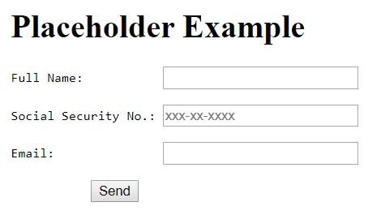
Text Field with Placeholder
<label for="so">Social Security No.:</label>
<input id="so" name="ss" placeholder="xxx-xx-xxxx" required="true" />
Demo: Ex: Placeholder

Slide 9
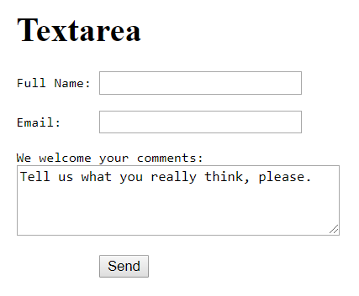
textarea
<label for="c">We welcome your comments:</label><br/>
<textarea id="c" name="feedback" rows="4" cols="40"> Tell us what you really think, please.</textarea>
Demo: Ex: TextArea

Slide 10
Input in Standard Formats
date—The input string must follow the date and time format specified by the Internet standard (RFC 3339) explained in.
month–In the form of yyyy-mm.
week—In the form of yyyy-Www where ww is between 01 and 53.

Slide 11
Additional Input Formats
email—An email address in the correct format.
url—An absolute URL or empty string, on one line.
number—A positive or negative integer or floating-point number.
range—A number within a given min="number" and
max="number" range with a specific step.
search—A plaintext string for searching, on one line.
tel—A telephone number, on one line.
color—A hex color name #rrggbb; color names or abbreviations are not allowed.

Slide 12
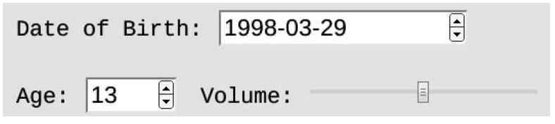
Sample Input Fields
<input type="date" name="birth" size="15" />
<input type="number" name="age" size="4"
min="0" max="200" maxlength="4" />
<input type="range" name="volume" min="0"
max="1" step="0.01" />

Slide 13
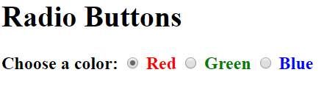
User Choices and Selections
Radio Buttons
<p style="font-size: larger; font-weight: bold;"> Choose a color:
<input id="r" type="radio" name="color"
value="red" checked="" />
<label for="r" style="color: red">Red</label>
<input id="g" type="radio" name="color" value="green" />
<label for="g" style="color: green">Green</label>
<input id="b" type="radio" name="color" value="blue" />
<label for="b" style="color: blue">Blue</label></p>
Demo: Ex: RadioButton

Slide 14
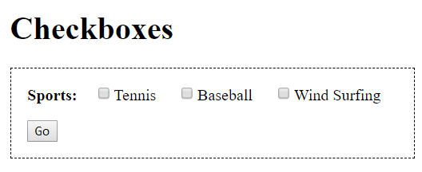
Checkboxes
<p style="font-size: larger; font-weight: bold;"> Sports: <input id="t" type="checkbox" name="tennis" />
<label for="t">Tennis</label>
<input id="b" type="checkbox" name="baseball" />
<label for="b">Baseball</label>
<input id="w" type="checkbox" name="windsurf" />
<label for="w">Wind Surfing</label></p>
Demo: Ex: CheckBoxes

Slide 15
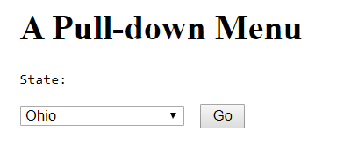
Pull-Down Menus
<label for="st">State:</label
<select id="st" name="state" size="1">
<option value="0"> Pick One </option>
<option value="Alabama"> Alabama </option>
<option value="Alaska"> Alaska </option>
...
</select>
Demo: Ex: PullDown

Slide 16
Menu Option Grouping
<form method="post" action="showdata.php">
<select id="menu" name="menu[]" size="8" multiple="multiple">
<optgroup label="Soup">
<option value="hot and sour">Hot and Sour Soup</option>
<option value="egg drop">Egg Drop Soup</option>
<option value="chicken noodle">Chicken Noodle Soup
</option> </optgroup>
<optgroup label="Salad">
<option value="garden">Garden Salad</option>
<option value="spinach">Spinach Salad</option>
<option value="fruit">Fruit Salad</option>
</optgroup></select></p></form>
Demo: Ex: OptGroup

Slide 17
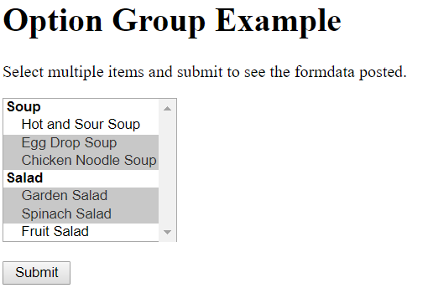
Menu Option Grouping

Slide 18
Form Submission
A user clicks on a submit button to trigger a sequence of browser actions to submit the completed form.
First, necessary validations are performed to make sure required entries have values and values have the correct formats. The user must fix any problems found and submit again.
Upon successful validation, the entire set of input, known as the formdata, is then encoded and sent to the designated server-side program using the desired HTTP method.
The form attribute method indicates the HTTP method post or get, action specifies the server-side program, and enctype sets the way data are encoded.

Slide 19
Form enctype
Possible enctypes are
application/x-www-form-urlencoded—Under this default encoding, the formdata is sent, under either the post or get method, as a query string consisting of name=value pairs separated by the & character with each name and value URL encoded.
multipart/form-data—Used together with the HTTP post
method when the form contains file uploading.
text/plain—Working under the post method, the name=value pairs are sent, verbatim without encoding, in a string separated by space characters.

Slide 20
Example application/x-www-form-urlencoded
POST /test HTTP/1.1
Host: foo.example
Content-Type: application/x-www-form-urlencoded
Content-Length: 27
field1=value1&field2=value2

Slide 21
Example multipart/form-data
POST /test HTTP/1.1
Host: foo.example
Content-Type: multipart/form-data;boundary="boundary"
--boundary
Content-Disposition: form-data; name="field1"
value1
--boundary
Content-Disposition: form-data; name="field2"; filename="example.txt"
value2
--boundary--

Slide 22
submit Buttons
The basic submit button for a form is
<input type="submit" value="button-label" />
Please use a meaningful button-label that relates to the purpose of the form. A form may have multiple Submit buttons with different values.
You may customize the look of a Submit button by using an
image input element
<input type="image" src="url" name="key" alt="..." />
Data sent to the server-side program are in the form
key.x=x0 key.y=y0
Alternatively
<button name="submit" value="join">Join the Club
</button>
Demo: Ex: ImageInput

Slide 23
File Uploading
Use the the file-type input element for file uploading.
<form method="post" action="upload.php" enctype="multipart/form-data">
<pre><input name="name" placeholder="Name"/><input type="email" name="email" placeholder="Email"/>
<label for="p">Your photo:</label> <input id="p" type="file" name="photo" accept="image/jpeg" />
<label for="r">Your report:</label> type="file" name="report" accept="application/pdf" />
<input id="r"
<input type="submit" name="submit" value="upload"/>
</pre></form>
Demo: Ex: FileUpload

Slide 24
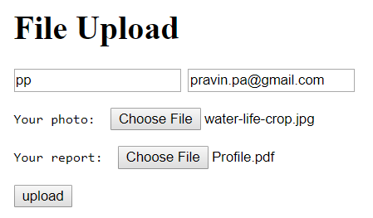
File Uploading

Slide 25
Other input Elements
<input | type="hidden" name="receiver"
<input | value="author@cs.kent.edu" />

Slide 26
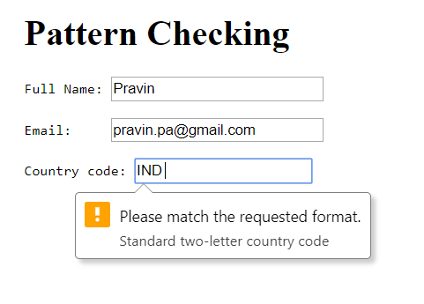
Input Validation Patterns
To check for correct input, you may specify a regular expression pattern:
<label for="c">Country code:</label>
<input type="text" id="c" name="c_code" pattern="[A-z]{2}"
title="Standard two-letter country code" />
Demo: Ex: PatternCheck

Slide 27
Layout and Styling of Forms
Text to explain the form is placed before and outside the form.
A form usually uses a single-column format. Related items, such as first name and last name, can be grouped on the same line.
Entries are labeled consistently, and the label tag is used to bind labels to input controls in the HTML code.
Required and optional entries are clearly indicated.
Client-side input validation is employed, and tooltips indicating required input formats are provided.
Avoid long forms. Group related entries together to divide a long form into smaller, more manageable parts.
Avoid repeatedly asking for the same information.

Slide 28
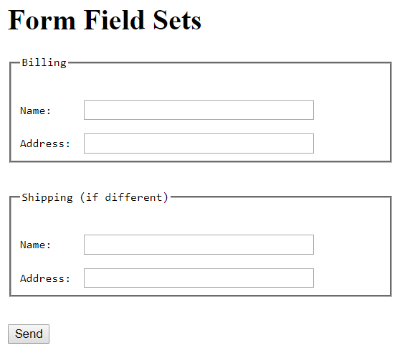
Grouping Form Entries
<fieldset>
<legend>Billing</legend>
...
</fieldset>
<fieldset>
<legend>Shipping (if different)</legend>
...
</fieldset>
Demo: Ex: FieldSet

Slide 29
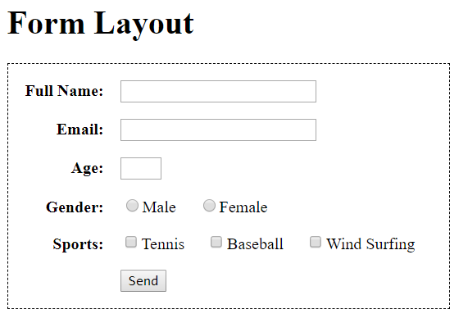
Tabular Form Layout
Forms are often displayed using a table layout to align the labels and input fields in a clear visual grid.
Demo: Ex: FormLayout

Slide 30
Shopping Cart Form
<form method="post" class="shopping">
<table id="cart"><caption><b>Your Cart</b></caption>
<thead><tr><th>Item</th><th>Code</th> <th>Price</th>
<th>Quantity</th> <th>Amount</th></tr></thead>
<tbody><tr>
<th>Hand Shovel</th>
<td class="center" >G10</td> <td>5.99</td>
<td><input type="number" size="4" name="G10_count" value="1" required=""/></td> <td>5.99</td></tr>
<!-- two more rows -->
</tbody></table><p class="buttons">
<input type="submit" name="submit"
value=" Update Cart " formaction="update.php"/>
<input type="submit" name="submit"
value=" Checkout " formaction="checkout.php"/>
</p></form>

Slide 31
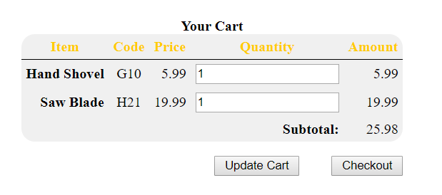
Shopping Cart Form
Demo: Ex: CartForm

Slide 32
Forms and HTTP
Connection —The client opens an HTTP connection to a server specified by the URL.
Query —The client sends an HTTP request to access a resource controlled by the server.
Processing —The server receives and processes the request.
Response —The server sends an HTTP response that can deliver the requested page, results of form processing, or an error message if something is wrong, back to the client.
Transaction finished —The transaction is finished, and the connection between the client and server may be kept open for a follow-up request, or it may be closed.

Slide 33
HTTP Message Format
initial line |  | (different for query and response)
HeaderKey1: | value1 | (zero or more header fields)
HeaderKey2: | value2
HeaderKey3: | value3
 |  | (an empty line separating header and body)
Optional message body contains query or response data. The amount and type of data in the body are specified in the headers.

Slide 34
The Query Line
A query line has three parts separated by spaces: a query method name, a server-side path (URI) of the requested resource, and an HTTP version number.
GET | /path/to/file/index.html | HTTP/1.1
POST | /cgi-bin/script.cgi | HTTP/1.1
HEAD | /path/to/file/index.html | HTTP/1.1
The GET method requests the specified resource and does not allow a message body.
The HEAD query requests only the header part of the response for the requested resource.
The POST method allows a message body consisting of formdata for server-side processing.

Slide 35
The Response Line
HTTP/1.1 | 200 | OK
HTTP/1.1 | 404 | Not Found

Slide 36
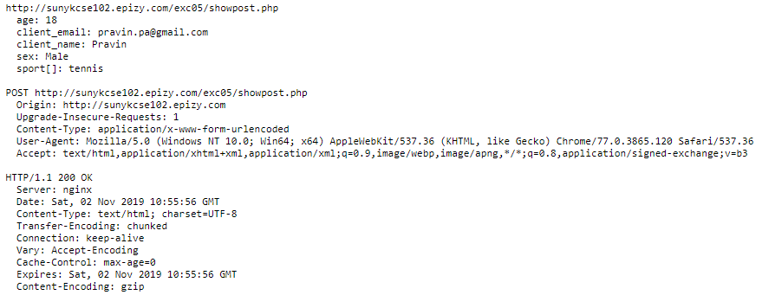
The POST Query

Slide 37
Data Posting via GET Queries
As an alternative to the POST query, formdata can be sent via a GET query by appending the form-urlencoded data at the end of the URL locating the server-side program.
In this case, the data sent are known as a query string and are joined to the URL by a ? character:
url of server side program?query string

Slide 38
Formdata Security and HTTPS
Web users care about protecting their sensitive and private information.
Every website with forms must display a privacy policy letting users know how the site will protect and use the information collected.
It is also important to assure users that the information submitted will not get into the wrong hands.
To protect the formdata during network transmission, secure HTTP (HTTPS) can be used for the form pages and their server-side programs.
This usually simply means switching from http:// to
https:// in the relevant URLs.

Slide 39
Form Processing Overview
Formdata sent from the client side require customized processing on the server side.
Whether via a POST or a GET request, the HTTP query carrying the formdata goes to a Web server. The Web server then relays the formdata to a target program (specified by the request URI) for processing.
The processing results, as output from the target program, comes back to the Web server, which sends that result back to the client as an HTTP response.
The target program may be a software module loaded into the server, a Java servlet, an active-page interpreter (ASP, JSP, PHP), or a stand-alone CGI program.

Slide 40
CGI Data Flow
Client
Request
Response
Web Host
STDOUT
Env Variables
Formdata or
STDIN
Query String
Web Server
PHP Program

Slide 41
PHP is short-form for Hypertext Preprocessor (earlier called, Personal Home Page)
Any query headers, query string, and other incoming data are sent to the PHP program through a set of predefined environment variables. These are also made available through predefined PHP variables.
A PHP program receives the GET query string through the environment variable QUERY STRING or the POST query body through standard input. PHP has built-in support to decode and parse the incoming data and make them available in PHP variables.
The PHP script may set content-type, content-length, and other HTTP headers before sending data to standard output that becomes the content of the HTTP response.

Slide 42
PHP Advantages
PHP scripts can be anywhere together with other Web documents.
PHP and code libraries are free and widely available.
PHP is designed for the Web and is a more efficient alternative for CGI. It is most efficient when PHP becomes a resident server module, as in the case of Apache.
PHP has database, email, ftp, pdf, image, and other support.
PHP has a built-in SQLite database and also interfaces well with major database systems, including the free and widely popular MySQL.
PHP uses familiar C syntax (mostly).
PHP has a large number of useful functions for the Web.
PHP offers a command-line interface, making it easy for testing and debugging PHP scripts.

Slide 43
PHP Scripting Overview
PHP is a high-level, interpreter-based scripting language designed for the Web. PHP code can embedded in HTML or other pages to produce dynamic content.
A PHP script contains active parts enclosed by the bracket
<?php ... ?> and static parts outside the brackets.
The PHP interpreter, often inside the Web server, filters a requested PHP file, replacing each bracket with any output generated by the code in that bracket and letting static content pass through untouched as output.
The inclusion or not of a particular static part can still be controlled by surrounding logic in php brackets. Within a php bracket, only output-producing statements generate output.

Slide 44
PHP Interpreter
Generated
Document
PHP
Browser
Web Server
file.php
PHP CODE
Fixed Content
For experimentation, use PHP sandbox available at:
http://sandbox.onlinephpfunctions.com/

Slide 45
<html xmlns="http://www.w3.org/1999/xhtml" lang="en" xml:lang="en">
<head><meta charset="utf-8"/>
<title>PHP Hello World</title></head><body>
<h1>Hello from PHP</h1><p>Hello, it is
<?php
if (function_exists("date_default_timezone_set")) date_default_timezone_set('US/Eastern');
echo date("l M. d, Y"); ?>,
<br />do you know where your project is?</p>
</body></html>
Demo: Ex: Hello.php
A PHP page must always produce a correctly formatted HTTP response message. Output from a PHP script constitutes the response body.

Slide 46
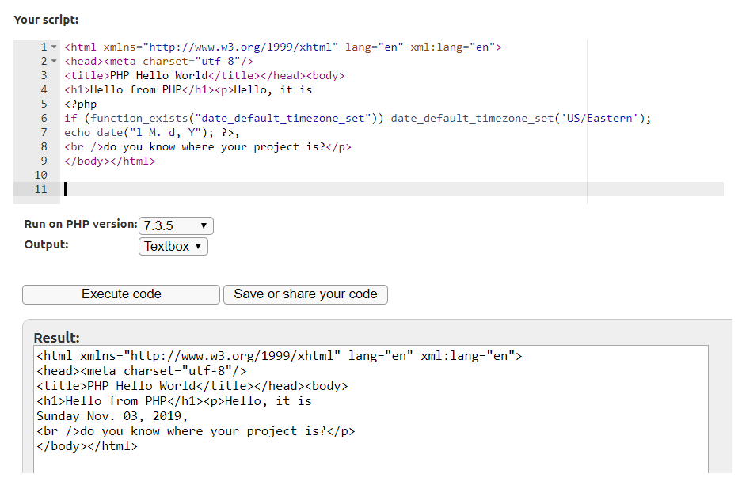
PHP Sandbox http://sandbox.onlinephpfunctions.com/

Slide 47
An Introduction to PHP
PHP Variables
The name of a variable in a PHP script always carries the $ prefix. Data from an incoming HTTP request are automatically made available in predefined super global variables:
$_POST—for post formdata
$_GET—for get formdata or query string
$_REQUEST—for either get or post request data
$_SERVER—for information related to the Web server, HTTP request headers, and the PHP script itself
$_ENV—for CGI defined variables and any form the shell used on particular operating systems

Slide 48
PHP Variables
Each of these is an associative array. For example, form data
item=Hammer&price=4.50 posted by a form is obtained in a PHP script with:
$product = $_POST['item'];// $product is Hammer
$cost = $_POST['price']; // $cost is 4.50

Slide 49
PHP Page Template
front.php
<!DOCTYPE html>
<html xmlns="http://www.w3.org/1999/xhtml" lang="en" xml:lang="en">
<head> <meta charset="utf-8"/>
<title><?php echo $page_title; ?></title>
</head> <body style="background-color:
<?php echo $page_background; ?>">
back.php
<footer><p style="font-size: small">Copyright
&copy; <?php echo $company; ?>.
All rights reserved</p></footer></body></html>

Slide 50
template.php
<?php $page_title="Educational Services";
$page_background="#def"; require("front.php");
?>
<p>Page content here </p>
<?php $company="sunykorea.ac.kr"; require("back.php");
?>
Demo: Ex: Template

Slide 51
PHP Conditionals
<?php // conditionals if ( $var )
{ /* $var is not 0, "0", "", 0.0, FALSE or null */ }
elseif ($var == 0)
{ /* $var is 0 or "0" else
{ /* otherwise
*/ }
*/ }
?>

Slide 52
PHP Test Expressions
Test expressions include >, <, ==, >=, <=, !=, === identical (== and same type), and !== (not ===).
Predicate functions such as is string($x),
file exists($file), isset($var), is array($a), and function exists($f), which produce a Boolean value (TRUE or FALSE), are also important in tests.
Logical operations on Boolean values are: &&, and, ||, or, !, and xor.

Slide 53
PHP-Defined Navbar
The navbar in file navbar.php:
<nav class="leftnavbar">
<?php if($page == "index.php") {?>
<span class="self">Main Page</span>
<?php } else {?>
<a href="index.php">Main Page</a><?php }?>
<?php if($page == "products.php") {?>
<span class="self">Products</span>
<?php } else {?>
<a href="products.php">Products</a><?php }?>
<?php if($page == "services.php") { ?>
<span class="self">Services</span>
<?php } else {?>
<a href="service.php">Services</a><?php }?>
<?php if($page == "news.php") { ?>
<span class="self">News</span>
<?php } else {?>
<a href="news.php">News</a><?php }?>
<?php if($page == "contact.php") { ?>
<span class="self">Contact</span>
<?php } else {?>
<a href="contact.php">Contact</a><?php }?>
</nav>

Slide 54
PHP-Defined Navbar
A webpage incorporating navbar.php will use the following code:
<?php $page=basename($_SERVER[’PHP_SELF’]) require_once("navbar.php"); ?>
Demo: Ex: Products

Slide 55
Strings in PHP
A PHP string is a sequence of ASCII characters (bytes). You can specify a string by enclosing ASCII and UTF-8 encoded UNICODE characters within single quotes or double quotes.
$name='Paul Wang';
$first='Paul'; $last="Wang";
$name="$first $last";
Two strings can be concatenated together with the dot operator (.).
$me = 'It\'s my name ' . $first . " $last\n";

Slide 56
PHP String Functions
strlen(str)—Returns the number of characters in str.
trim(str)—Returns a string by stripping white space (or other characters) from both ends of str.
substr(str, i [, len])—Returns a substring of str from position i (zero-based indexing) to the end or to length len.
strstr(line, word)—Finds first instance of a string word in the longer string line and returns a substring of line that begins with word.
strtolower(s), strtoupper(s)—Returns the lowercase, uppercase version of s.
strcmp(str 1, str 2)—Returns a positive, negative, or zero integer if str 1 is greater than, less than, or equal to str 2.
md5(str)—Returns the MD5 digest of str.
urlencode(str)—URLencode str and returns a proper query string.

Slide 57
Arrays in PHP
A PHP array supports numerical indexing (zero based) and string indexing (associative) at the same time. Thus, each PHP array entry is always a key-value pair.
<?php
$a = array(2, 3, 5, 7); // $a[0] is 2
// $a is the same as array(0=>2, 1=>3, 2=>5, 3=>7)
$b =array("first_name"=>"Paul", "last_name"=>"Wang");
$c = array(5 => "red", "fox");
$a[5]=100; // no $a[4] is fine
$b['email']="author@booksite.com";
?>

Slide 58
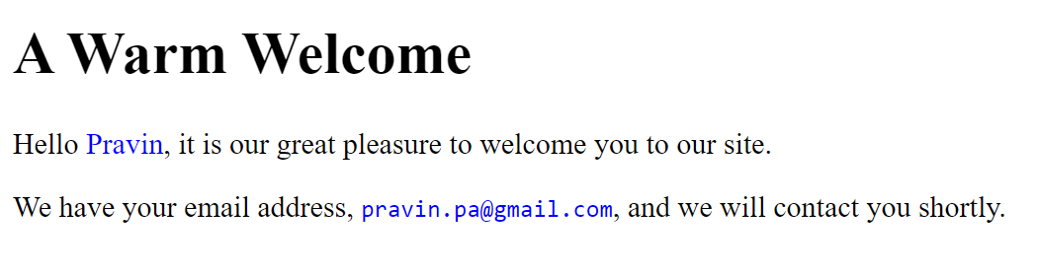
Form Response: Welcome

Slide 59
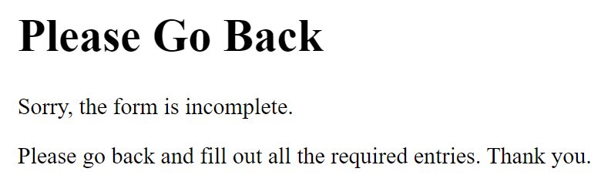
Form Response: Sorry

Slide 60
Getting Started with Form Processing
PHP script welcome.php starts with the code:
<?php
$title="A Warm Welcome";
if ( empty($_POST[’client_name’])
||
trim($_POST[’client_name’])==="" || empty($_POST[’client_email’]) || trim($_POST[’client_email’])==="" )
{ $error=TRUE;
$title="Please Go Back";
}
?>
to check formdata.

Slide 61
welcome.php generating the response page:
<!DOCTYPE html>
<html xmlns="http://www.w3.org/1999/xhtml"
lang="en" xml:lang="en">
<head><meta charset="utf-8"/>
<title><?php echo $title; ?></title></head>
<body style="background-color: #def">
<h1><?php echo $title; ?></h1>
<?php if ( isset($error) ) {?>
<p>Sorry, the form is incomplete.</p>
<p>Please go back and fill out all the required entries. Thank you.</p>
<?php } else { ?>
<p>Hello <span style="color: blue">
<?php echo $_POST[’client_name’]; ?></span>, it
is our great pleasure to welcome you to our site.</p>

Slide 62
<p>We have your email address, <code style="color: blue">
<?php echo $_POST[’client_email’]; ?></code>, and we will contact you shortly.</p>
<?php } ?>
</body></html>
Demo: Ex: FormAction

Slide 63
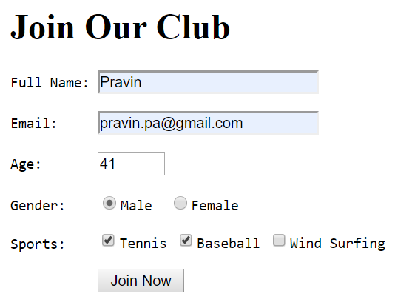
Joining a Club
Demo: Ex: JoinClub

Slide 64
Form Processing Example: Club Membership
The Form
<form method="post" action="joinaction.php">
<label>Full Name: <input required="" name="client_name" size="25"/></label>
<label>Email: <input required="" type="email" name="client_email" size="25" /></label>
<label>Age: <input type="number" title="18-65" name= "age" required="" size="6" min="18" max="65"/></label>

Slide 65
Gender: <label><input type="radio" name="sex" value= "Male" />Male </label> <label><input type="radio" name="sex" value="Female" />Female</label>
Sports: <label><input type="checkbox" name="sport[]" value="tennis"/>Tennis </label>
<label><input type="checkbox" name="sport[]" value="baseball"/>Baseball </label>
<label><input type="checkbox" name="sport[]" value="windsurf"/>Wind Surfing</label>
<input type="submit" value=" Join Now " />
</form>

Slide 66
Checks the incoming formdata
Sends an error message to the user if any input is missing or incorrect
Sends the form-collected information by email to the club manager with cc to the user. It is important to send the correct email From field to identify the message as coming from the particular site/organization. Note how we used the PHP constant PHP_EOL (end-of-line sequence) to format the correct email headers.
Sends a response page to the user

Slide 67
The joinaction.php script:
<?php
if ( empty($_POST[’client_name’]) || empty($_POST[’client_email’])|| empty($_POST[’age’]) ||
! is_numeric($_POST[’age’])
)
{ $error=TRUE;
$title="Please Go Back"; } else
{ require_once("email.php");
$msg="We have emailed";
$to="manager@club.com";
$subject="Club Membership";
$title="Thanks for Joining Our Club";
$cc= ’Cc: "’ .$_POST[’client_name’] .’" <’

Slide 68
. $_POST[’client_email’] . ’>’;
$headers =
’From: "Super Club" <service@superclub.com>’
. PHP_EOL . $cc . PHP_EOL . ’X-Mailer: PHP-’
. phpversion() . PHP_EOL; if ( ! email_formdata($to,
$_POST[’client_email’], $subject))
{ $msg=’<span style="color: red">We failed to email</span>’;
}
}
?>

Slide 69
The Response Page
joinclub.php script now begins to send the response page.
<?php $bg="#def"; require("rfront.php"); ?>
<h1><?php echo $title; ?></h1>
<?php if ( isset($error) ) {?>
<p>Sorry, the form is incomplete.</p>
<p>Please go back and fill out all the required entries. Thank you.</p>
<?php } else { ?>
<p>Thank you <span style="color: blue">
<?php echo $_POST[’client_name’]; ?></span> for joining our club.</p>
<p><?php echo $msg; ?> your request to our manager, with a copy to <code style="color: blue"> <?php echo $_POST[’client_email’];?>
</code>.</p><?php }require("rback.php"); ?>

Slide 70
Sending Email from PHP
<?php
function email_formdata(&$to, &$subject,
&$headers)
{ if (mail($to, $subject, formdata(),
$headers))
{ return TRUE; } return FALSE;
}
mail($to, $subject, $body [, mail headers ])
Forms-100

Slide 71
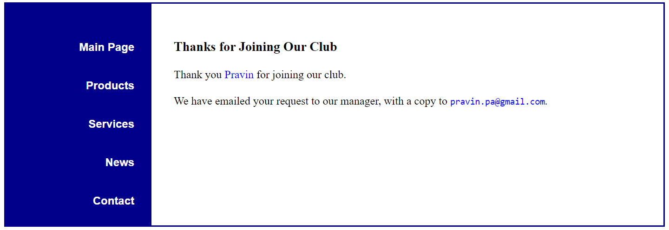
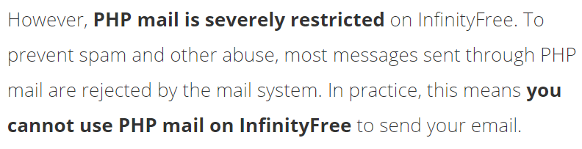
Response Page

Slide 72
PHP Array Functions
count($ar) empty($ar)
unset($ar), unset($ar[$n]) array_keys($ar) array_values($ar) array_pop($ar) array_push($ar,$e1,$e2,...) array_shift($ar) array_unshift($ar,$e1,...) array_reverse($ar) ksort($ar),krsort
Returns the number of entries in $ar
Returns true if $ar is empty Deletes the array or entry Returns an array of keys Returns an array of values
Pops and returns last entry, or null
Inserts at end of array
Pops and returns first entry, or null
Adds at beginning of array Returns a reversed array
Sorts array keys in increasing or decreas- ing order

Slide 73
Loops in PHP
// displays 0 to 9
for ($i = 0; $i < 10; $i++) { echo "$i\n"; }
$i=30; | // | displays | 30 to 0
while ( $i=50; | $i // | >= 0 ) { displays | echo "$i\n"; $i--; } 50 to 1
do { echo "$i\n"; $i--; } while ($i);
reset($arr);
while ( list($key, $val) = each($arr) )
{ /* go through array */ }
reset($arr);

Slide 74
HTTP Request Data Exposed
<?php
if ( ! empty($_REQUEST) ) // if not empty
{ echo "<pre>";
foreach($_REQUEST as $key => $val)
{ if ( is_array($val) ) echo " $key = ",
implode(", ", $val), "\n\n"; else
echo " $key = $val\n\n";
}
echo "</pre>";
}
else
echo "<p>Warning: No input data.</p>";
?>
Demo: Ex: ShowRequest

Slide 75
